Slide 1




TEAM
ANALYTICS AVENGERS
Problem Statement:
Customer Churn Prediction and Retention Prioritization
Presented
  Snoohith
  Mohan Vamsi
  Indu Priya
  Akhil
  Mohammad Irfan

Slide 2
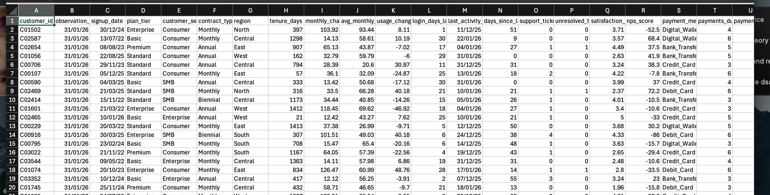
a payment gateway, faces merchant churn due to settlement delays, and declining transaction activity.
The project uses machine learning to predict merchant churn within 30 days and prioritize high-risk, high-value merchants for targeted retention strategies.
generated a synthetic data with 5000 rows and 30 columns
Target variable : - churn_30d

Slide 3
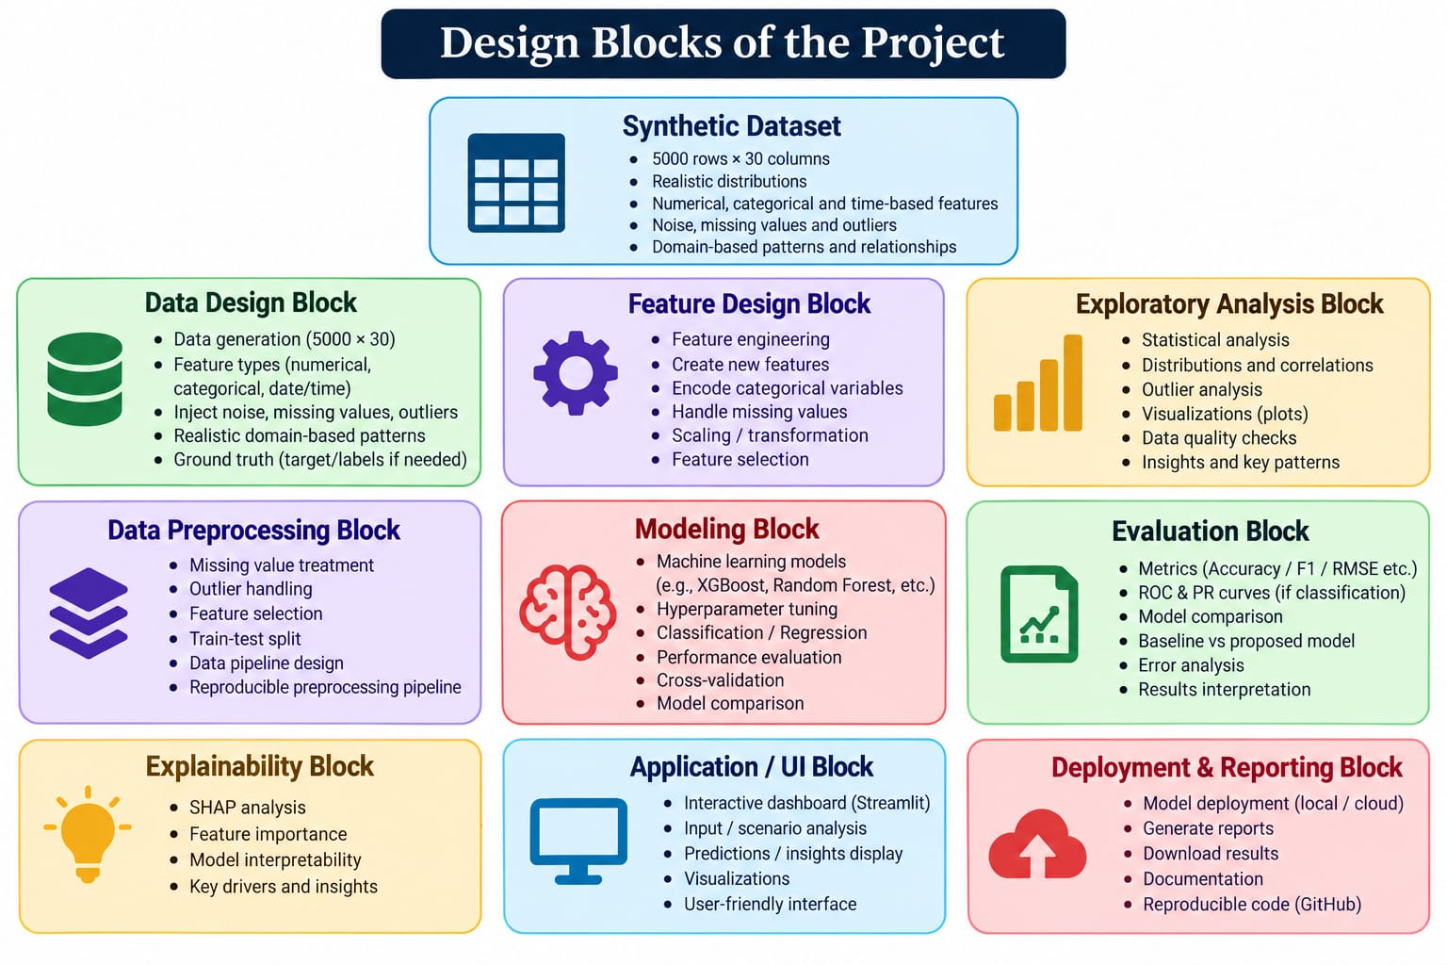

Slide 4
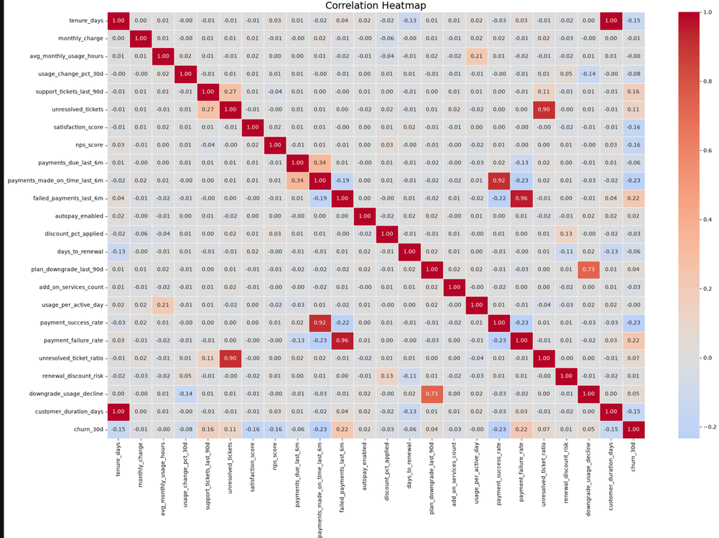
EDA was performed to analyse customer behaviour and identify patterns associated with churn using descriptive statistics, boxplots, and correlation heatmaps.
We compared churned and retained customers based on usage, payment behaviour, satisfaction, and support interactions to identify potential churn indicators.
Feature Engineering
  usage_per_active_day
  engagement_decline_score
  payment_success_rate
  payment_failure_rate
  unresolved_ticket_ratio
  renewal_discount_risk
  downgrade_usage_decline

Slide 5
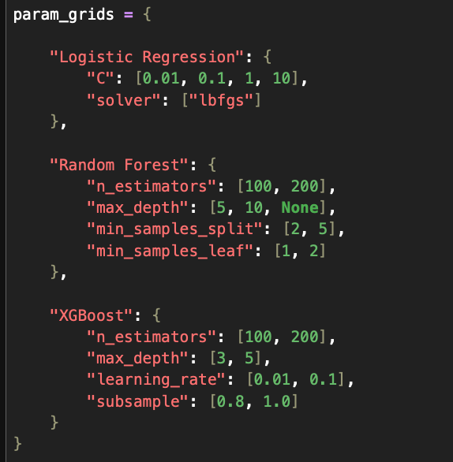
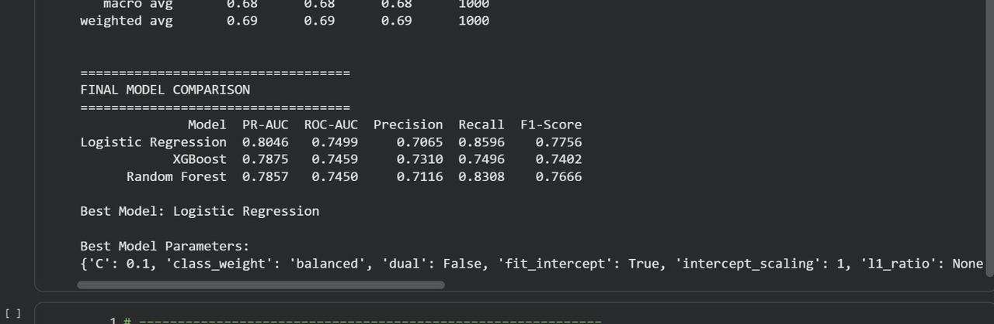
Machine Learning Model Development:
  Problem formulation: Defined churn prediction as a supervised binary classification task (churn_30d: 0 = No churn, 1 = Churn).
  Data preparation: Performed chronological train-validation split of 5 standardization, and one-hot encoding.
  Model development: Trained and compared Logistic Regression, Random Forest, and XGBoost classifiers.
  Hyperparameter tuning: Applied GridSearchCV with TimeSeriesSplit.
  Model evaluation: Compared models using PR-AUC, ROC-AUC, Precision, Recall, and F1-score.

Slide 6
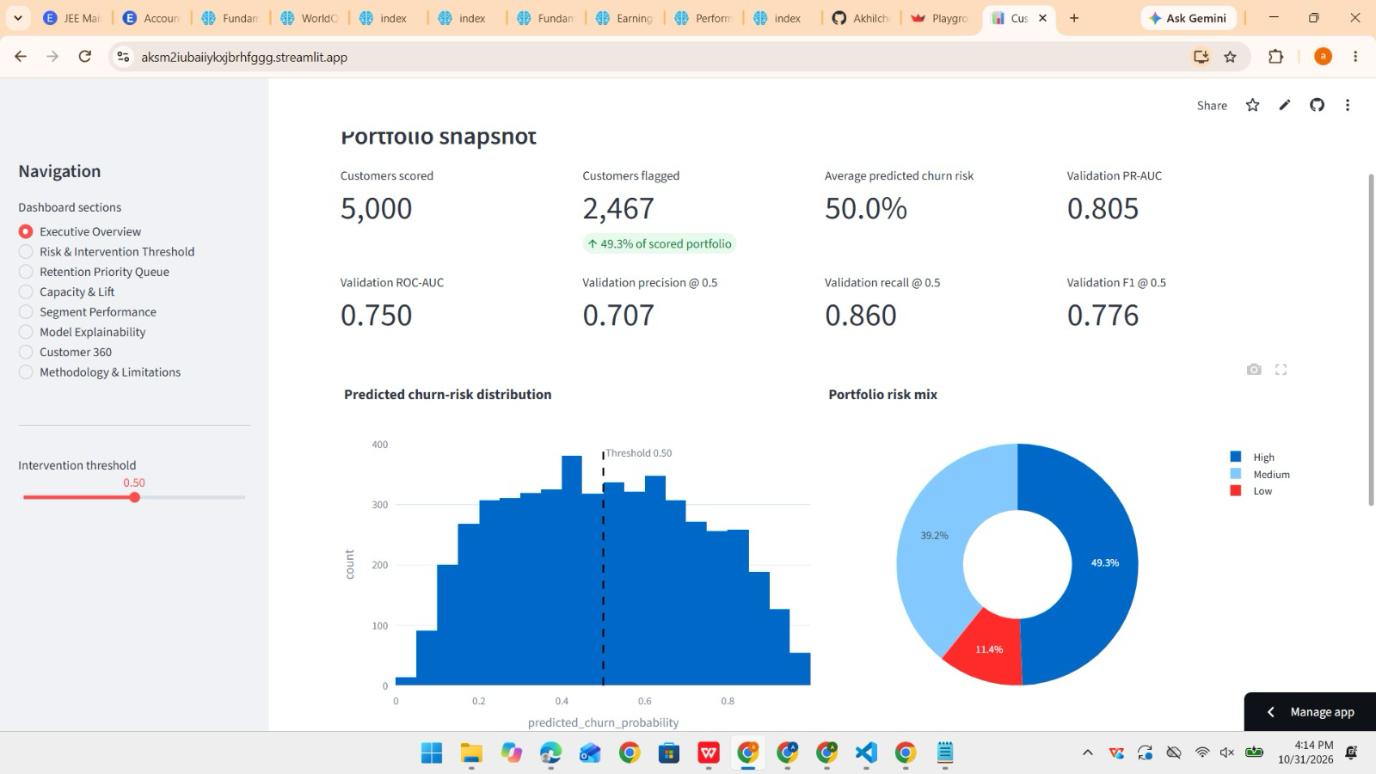
Dash Board

